Slide 1
Introduction to Software Engineering – Video Presentation and Explanation
By : Yino Alva

Slide 2

Introduction to Software Engineering
What is Software Engineering?
  Software engineering is an engineering discipline concerned with all aspects of software production, applying systematic, disciplined, and quantifiable approaches to the development, operation, and maintenance of software.
  Historical Context (NATO Conferences 1968 & 1969): The term was popularized during the 1968 and 1969 NATO Software Engineering Conferences in Garmisch, Germany, and Rome, Italy. These conferences were convened to address the "Software Crisis“, a period where software projects routinely ran over budget, missed deadlines, contained numerous bugs, and proved difficult to maintain.

Slide 3
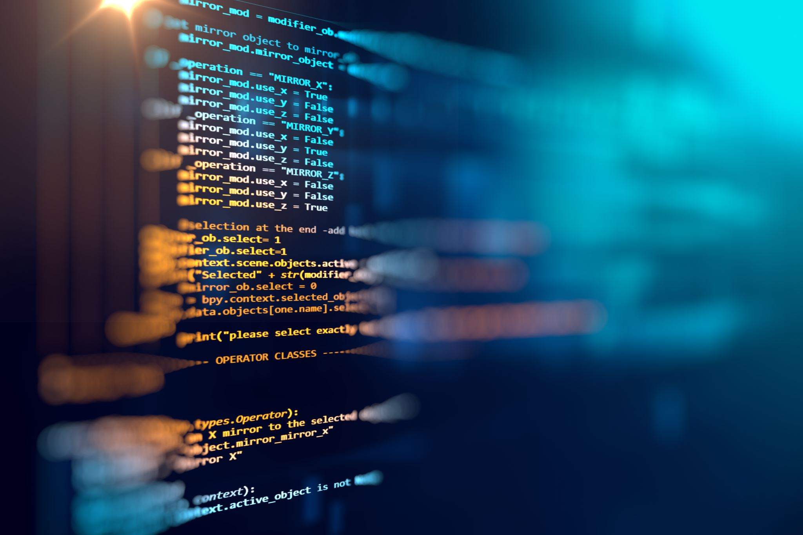
Overview of software engineering’s role in professional software development.
  Software engineering transforms informal coding practices into an organized professional discipline. It ensures software systems are reliable, scalable, secure, and cost-effective to meet real-world business requirements.

Slide 4
See you in Part 2

Slide 5
Introduction to Software Engineering – Part 2-Key Concepts in Software Engineering
By : Yino Alva

Slide 6
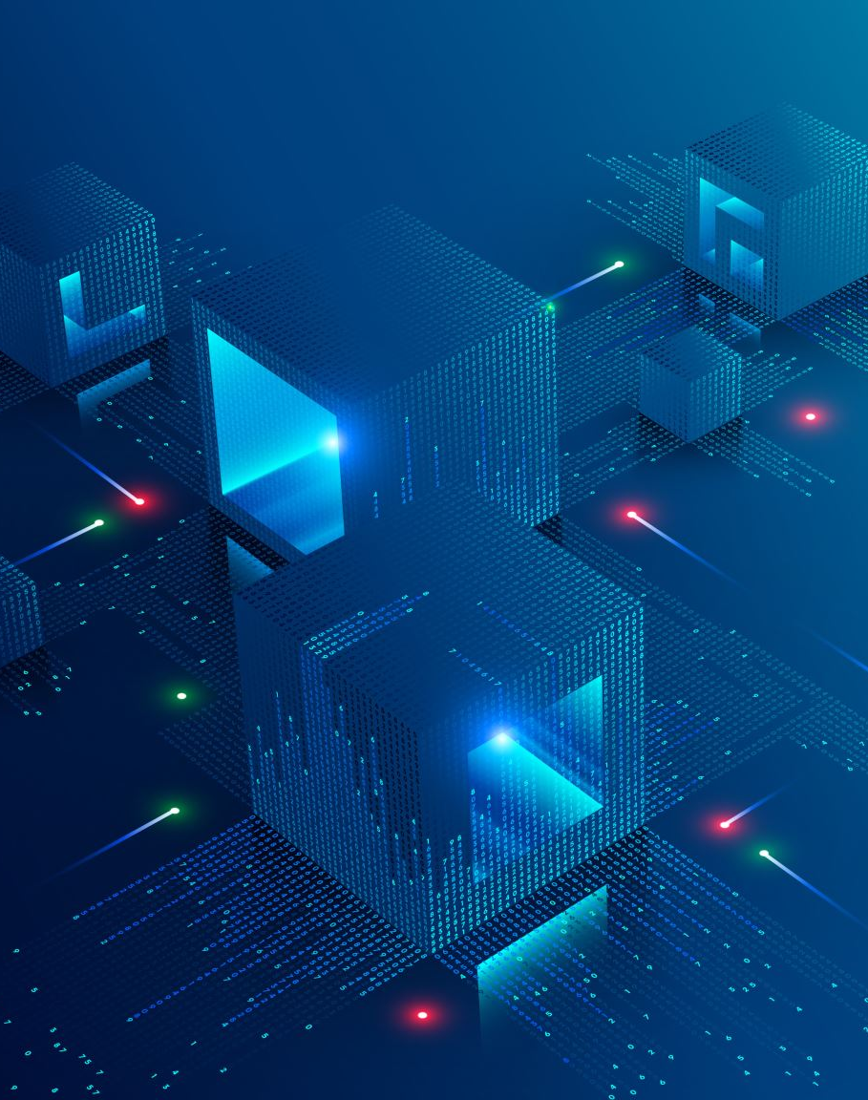
Software Engineering vs. Software Programming:
Distinction between software engineering and software programming: Programming is typically done by a single developer on "toy" or one-of-a-kind applications with short lifespans and minimal maintenance. Software engineering involves teams with distinct roles building complex system families meant to last and evolve.

Slide 7
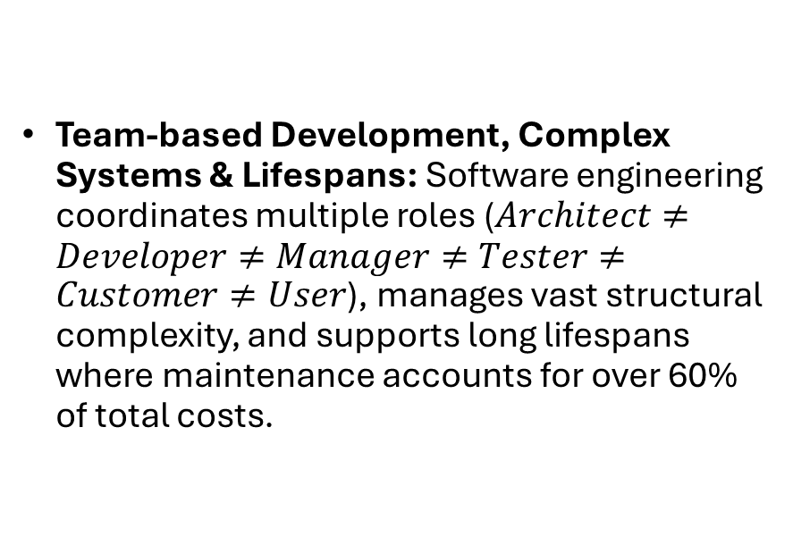
Software Engineering vs. Software Programming:
Team-based Development, Complex Systems & Lifespans: Software engineering coordinates multiple roles ($Architect≠Developer≠Manager≠Tester≠Customer≠User$), manages vast structural complexity, and supports long lifespans where maintenance accounts for over 60% of total costs.

Slide 8

Software Process and Development:
Scope as a Discipline: Covers the study of software processes, development principles, techniques, notations, project management, and quality assurance.
Processes, Techniques, and Notations: Uses structured processes (e.g., Waterfall, Agile, Incremental), technical techniques (e.g., continuous integration, component reuse), and standardized notations (e.g., UML diagrams) to define and design systems.

Slide 9
See you in Part 3

Slide 10
Introduction to Software Engineering – Part 3-Software Costs and Maintenance
By : Yino Alva

Slide 11
Understanding Software Costs:
Development vs. Maintenance Costs: Maintenance costs far exceed initial development costs for long-life systems, making up over 60% of total software production expenditure.
Why Maintenance is More Expensive : Software must continuously evolve to meet changing user requirements, adapt to new hardware/platforms, fix bugs in production, and preserve domain knowledge when team members leave.

Slide 12

Economic and Management Aspects:
Importance of Managing Costs: Quicker initial development is not always better; higher up-front investment in good design reduces long-term maintenance overhead. Cost estimation ensures projects remain viable and deliver ROI.

Slide 13

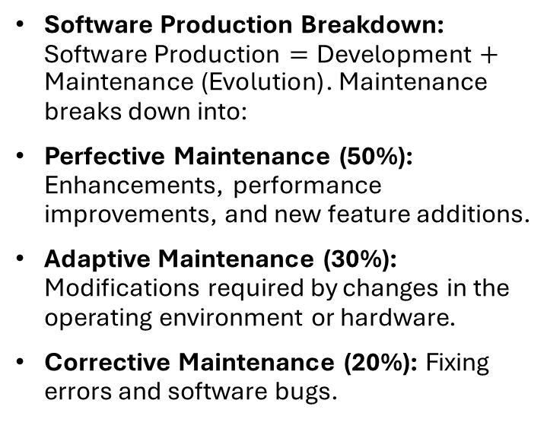
Economic and Management Aspects:
Software Production Breakdown: $\text{Software Production}=\text{Development}+\text{Maintenance (Evolution)}$. Maintenance breaks down into:
Perfective Maintenance (50%): Enhancements, performance improvements, and new feature additions.
Adaptive Maintenance (30%): Modifications required by changes in the operating environment or hardware.
Corrective Maintenance (20%): Fixing errors and software bugs.

Slide 14
See you in Part 4

Slide 15
Introduction to Software Engineering – Part 4-Challenges in Software Engineering
By : Yino Alva

Slide 16

Unique Challenges:
Difference from Other Engineering Fields: Software is intangible, highly malleable, lacks physical constraints, and operates with a discontinuous operational nature.

Slide 17

Unique Challenges:
Inherent Difficulties:
Complexity: Software parts are non-identical and complexity grows non-linearly with size.
Human-Intensive Processes: Software construction relies heavily on human intellect and team dynamics.
Malleability: Because software is easy to change relative to hardware, users expect continuous modifications.

Slide 18
Estimating Software Development Resources:
Algorithmic Cost Modeling: Mathematical formulas based on code size and project attributes (e.g., COCOMO).
Expert Judgment: Domain experts iterate until reaching a consensus on required effort.
Analogy-Based Estimation: Comparing the current project against a database of similar past projects

Slide 19
Estimating Software Development Resources:
Predicting Time, Effort, and Budget Challenges: Estimation is inherently difficult because initial requirements are often vague, technology or hardware may be unfamiliar, team composition varies, and requirement volatility introduces unpredictable scope changes.

Slide 20
Thank you

